Slide 1
Analysis of Streptococcus pneumoniae in Bangladesh
Krishna Banik Pushpita, Intern
Child Health Research Foundation, Bangladesh
09 January 2023

Slide 2

Streptococcus pneumoniae
Invasive pneumococcal disease (IPD) is an acute and serious infection caused by Streptococcus pneumoniae that predominantly affects children under five years of age.
Globally, this pathogen causes over 9 million cases and 300 thousand deaths every year, majority of which occur in low-and-middle-income countries

Slide 3
Streptococcus pneumoniae
In Bangladesh, more than 50 different serotypes have been detected to cause IPD cases and 78% of them occur within the first year of life.
To reduce burden of invasive pneumococcal disease, Bangladesh introduced the 10-valent Pneumococcal conjugate vaccine in the national routine vaccination in March 2015.

Slide 4
Streptococcus pneumoniae
Using a hospital-based surveillance conducted by the Child Health Research Foundation (CHRF), we are trying to observe...

Slide 5
QUESTIONS
01 | Which serotypes are more likely to cause meningitis? | 04 | Is there any correlation between hospital duration and serotype?
02 | Show the temporal changes in serotype distribution. | 05 | Is there any correlation between age and serotype?
03 | Which serotypes are more likely to cause death/DORB/referred/discharge? | 06 | Geographical distribution of the serotypes?

Slide 6
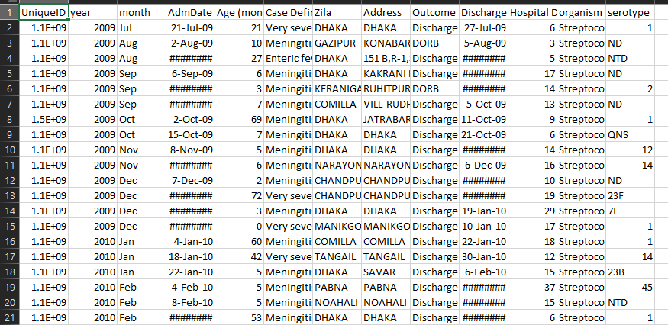
Dataset of Dhaka Shishu Hospital

Slide 7
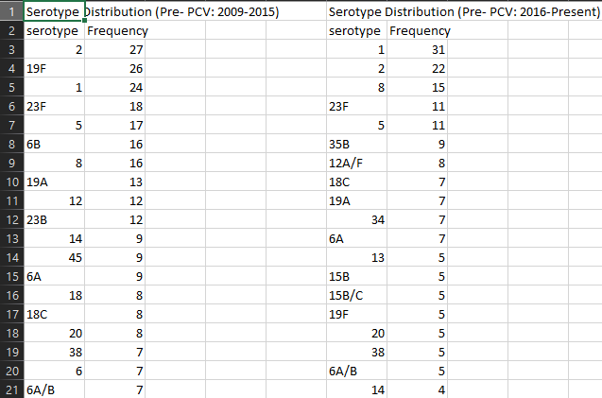
Dataset of Dhaka Shishu Hospital

Slide 8
Dataset of Dhaka Shishu Hospital
Total Sample: 789
Features or variables: Year, Age, Case Definitions, Zilla, Outcome,
Hospital Duration, Serotypes
Omitted Serotypes: ND,NTD,NoPCV13,QNS,NON TYPABLE

Slide 9
Question 01:
Which serotypes are more likely to cause meningitis?

Slide 10
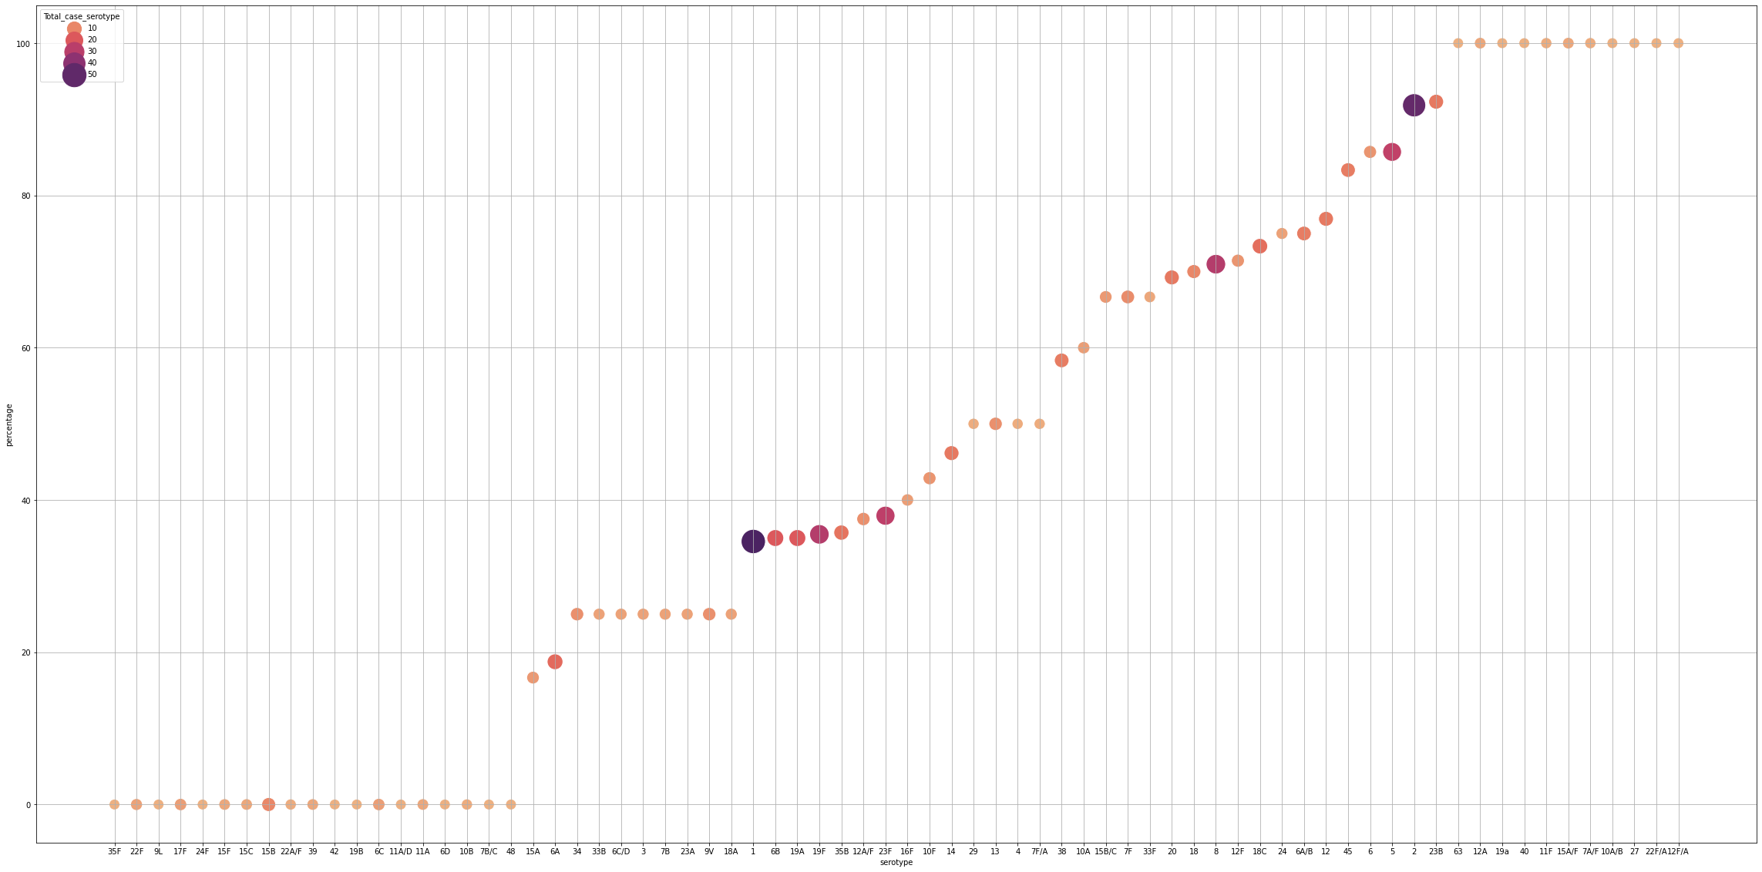
Propensity to cause meningitis for Spn serotypes
Serotype 2 (91.84%)
Serotype 5 (85.71%)
Serotype 8 (70.96%)
Percentage
Serotype 1 (34.545%)
Serotype

Slide 11
Question 02:
Show the temporal changes in serotype distribution.
Here we have considered:
On March, 2015 PCV-10 was introduced.
PCV-10: 1, 4, 5, 6B, 7F, 9B, 14, 18C, 19F, 23F
Pre PCV: Till march 2015
Post PCV: From April 2015

Slide 12
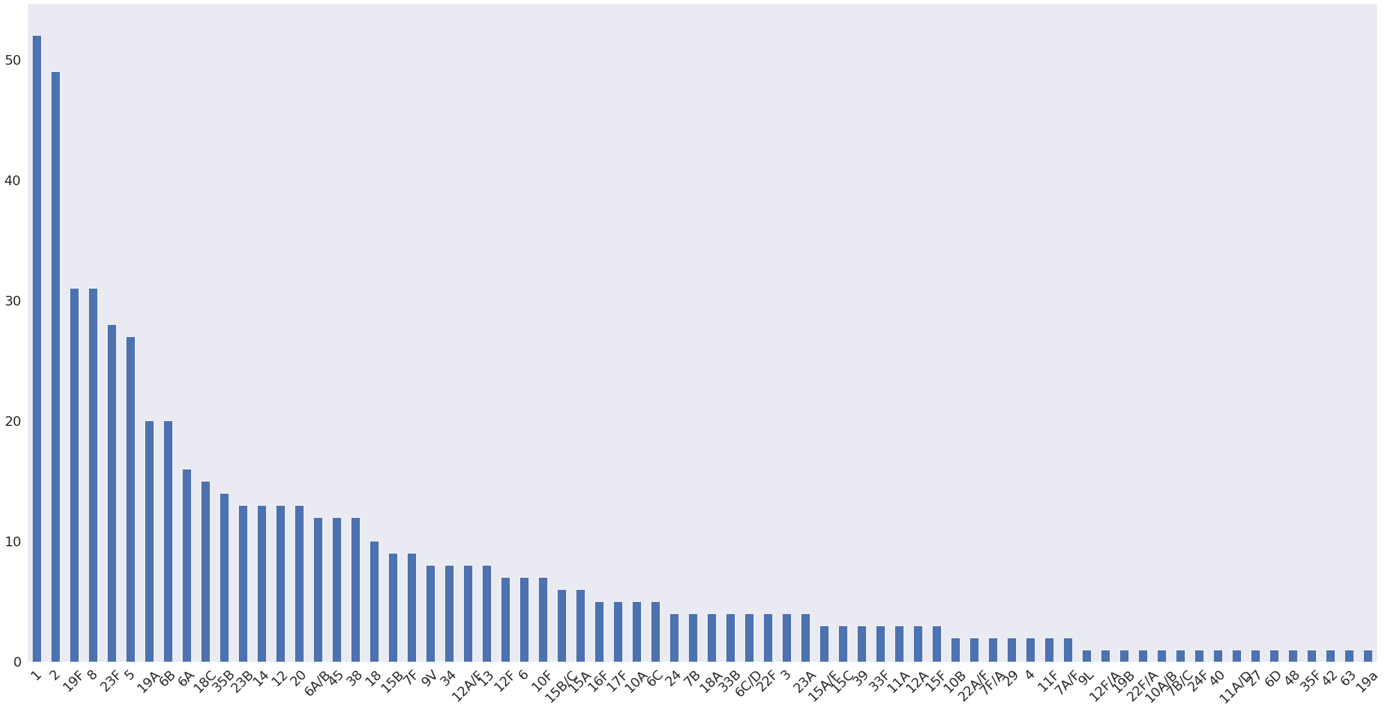
Distribution of serotypes for Spn in Bangladesh

Slide 13
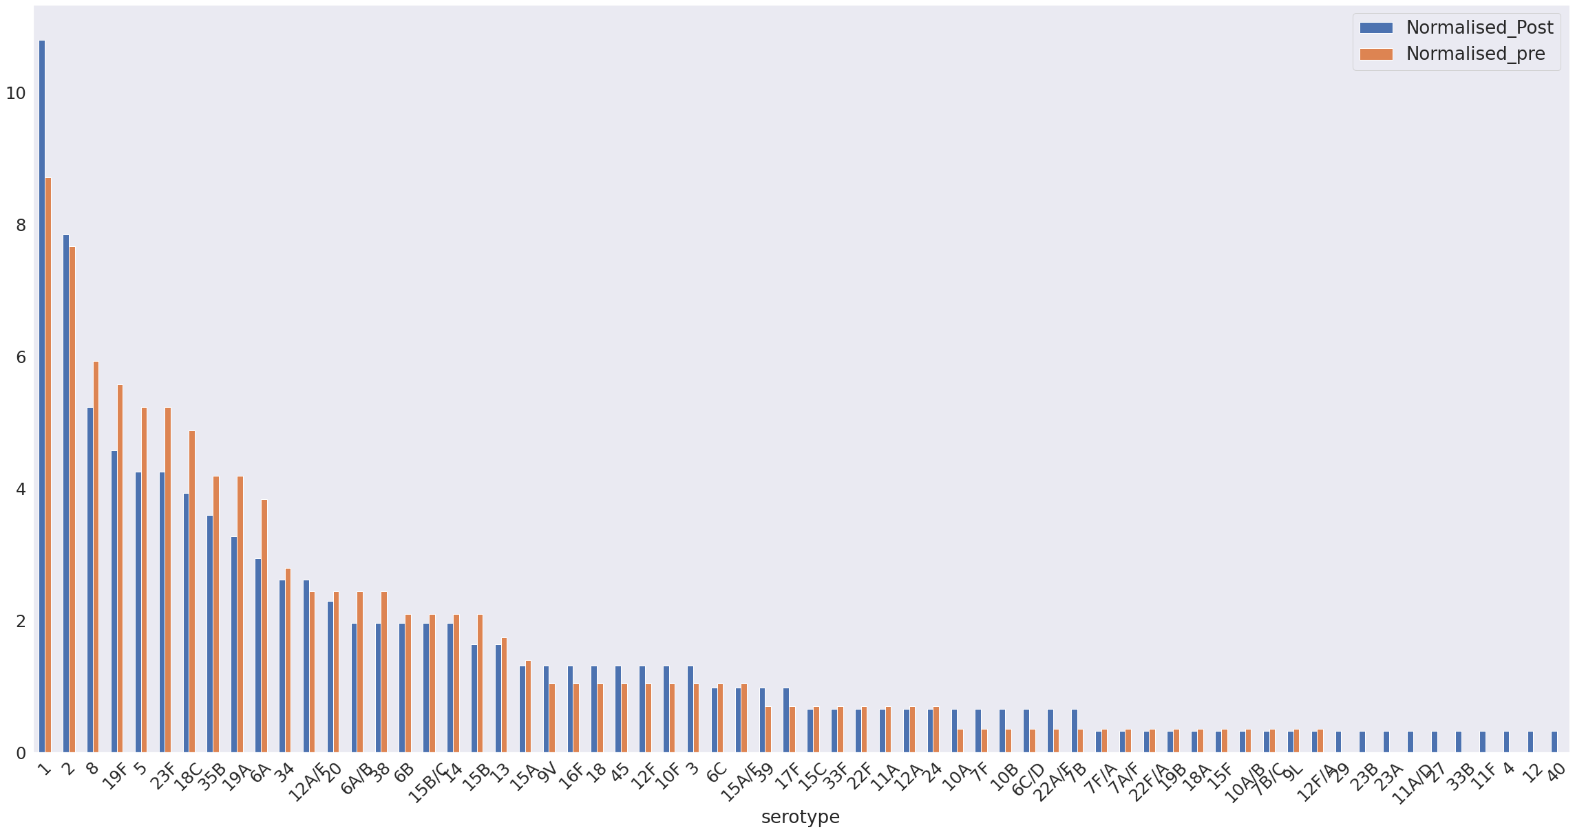
Frequency of serotypes Before PCV and after PCV (Normalised):

Slide 14
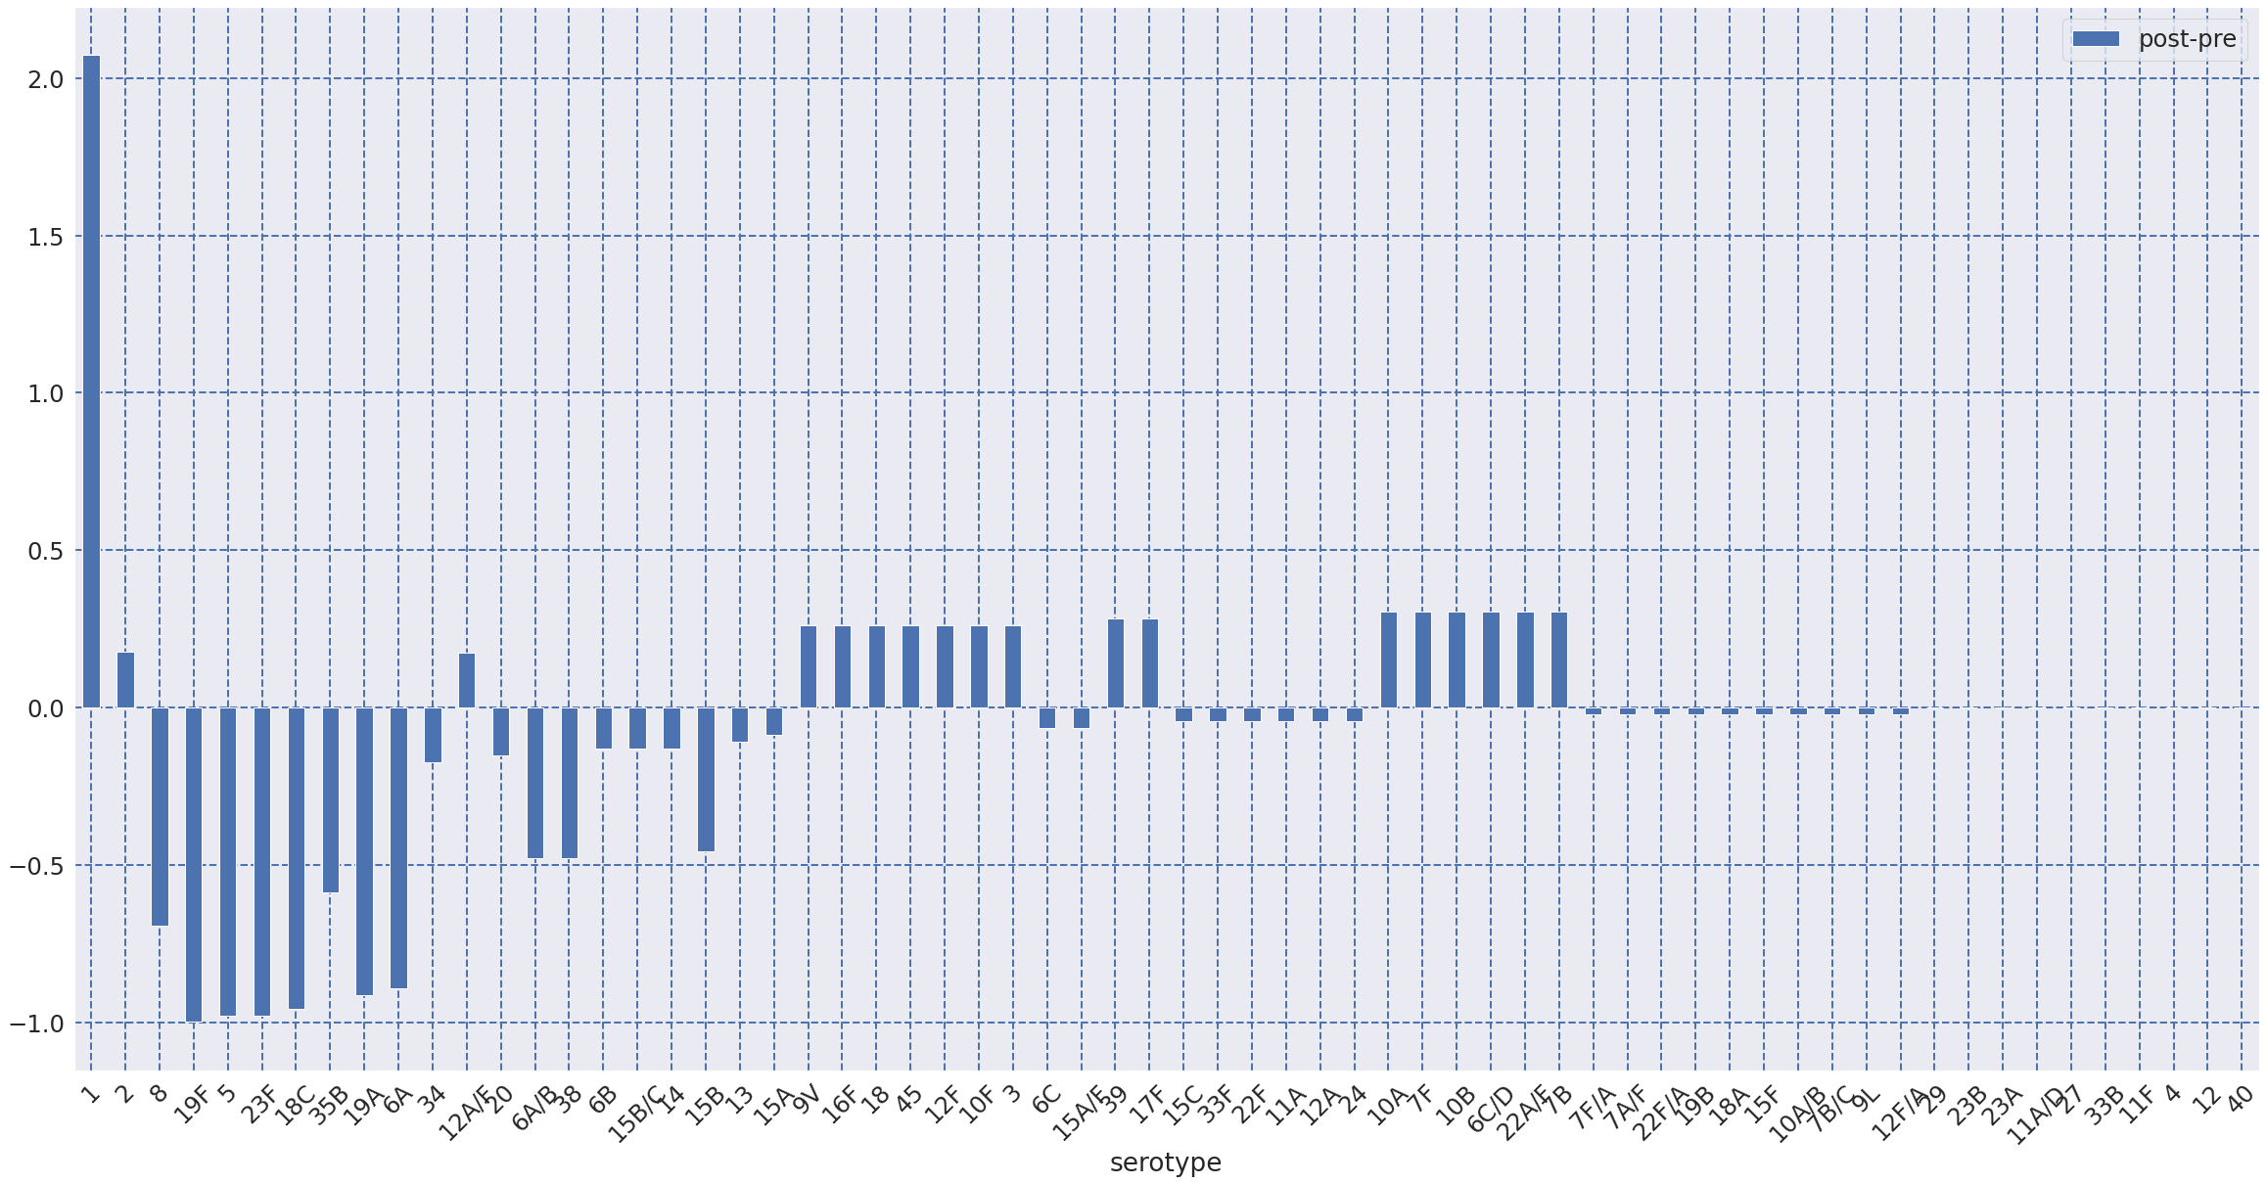
Frequency of serotypes: Post-Pre (Normalised):

Slide 15
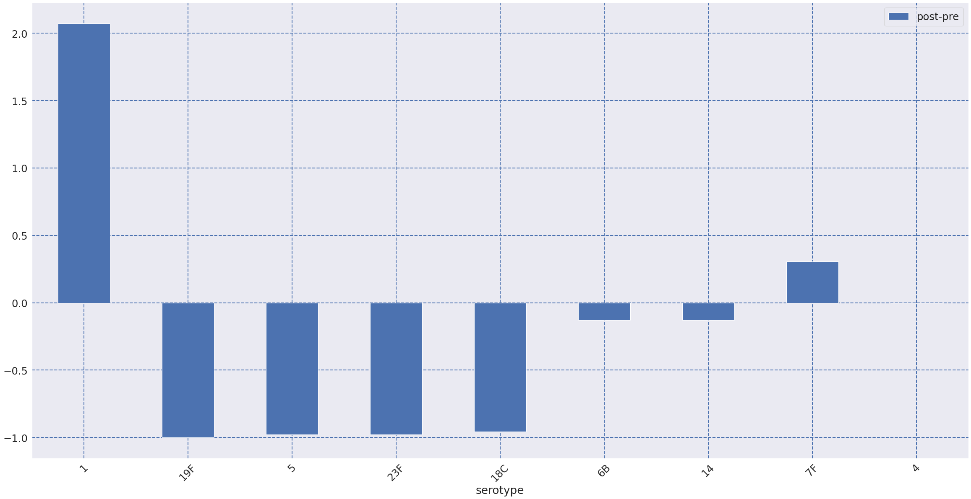
PCV-10: Post-Pre (Normalized):

Slide 16
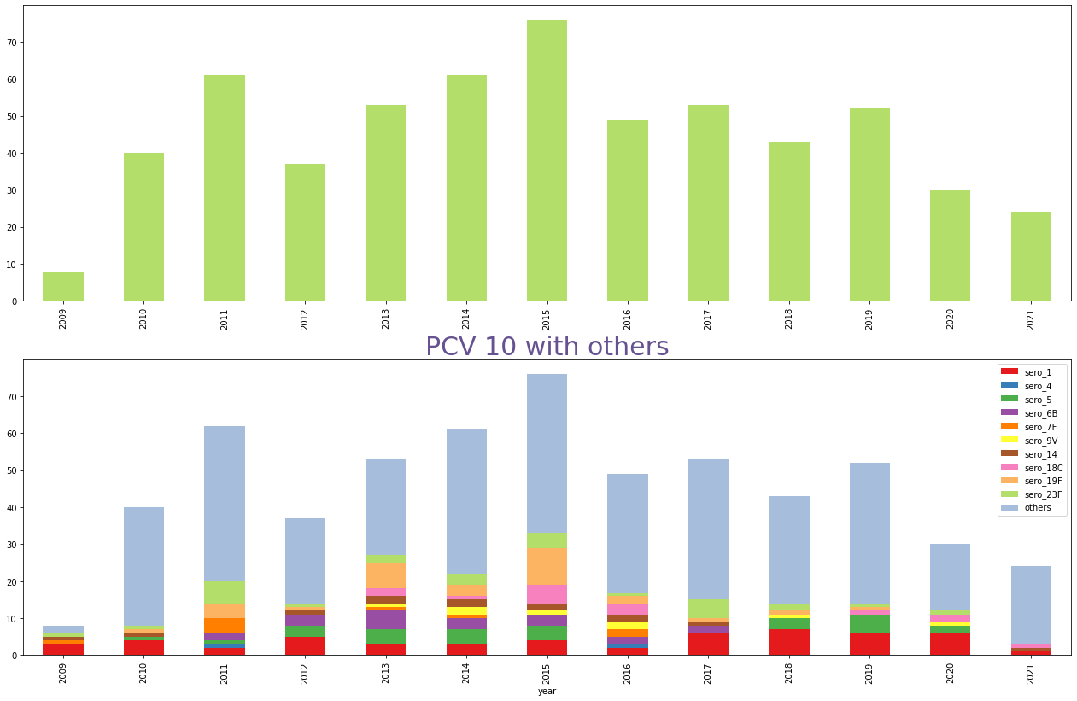
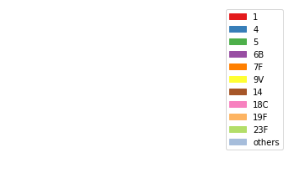
Distribution of Year Considering PCV10 :

Slide 17
Question 03:
Which serotypes are more likely to cause death/DORB/referred/discharge??

Slide 18
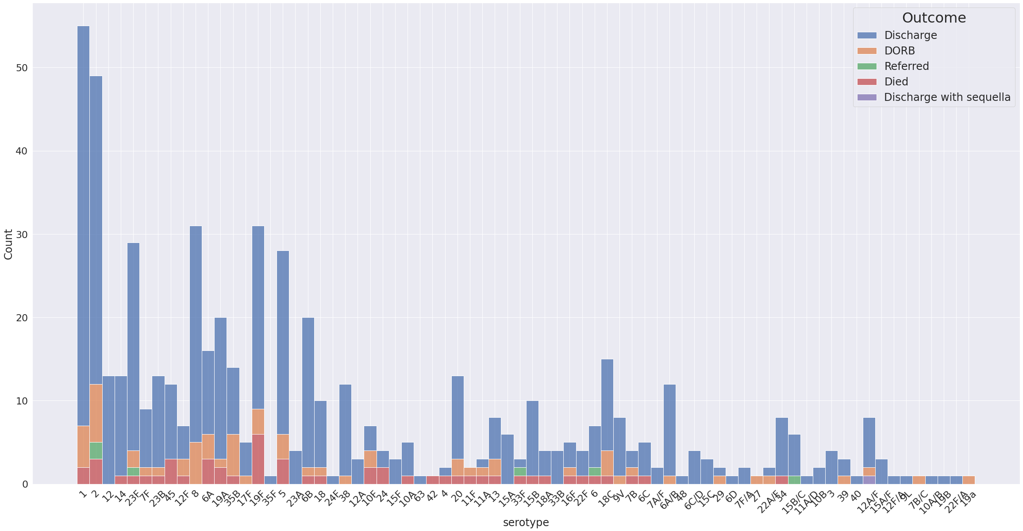
Distribution of serotypes for Spn in Bangladesh

Slide 19
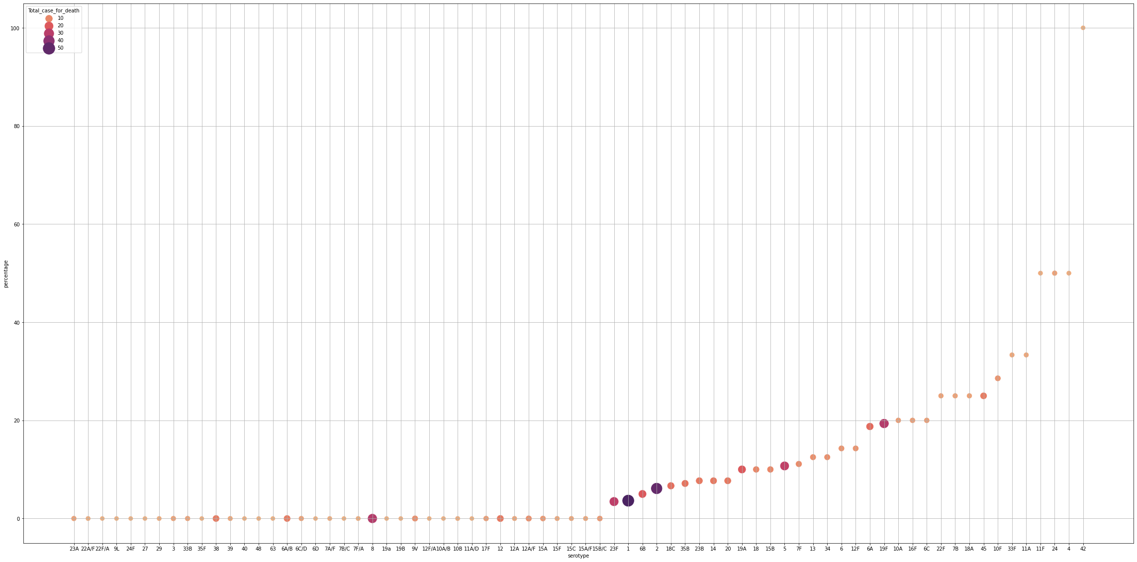
For Death
Percentage
Serotype 19F (19.35484%)
Serotype 2 (6.1224%)
Serotype 1 (3.6363%)
Serotype 5 (10.71429%)
Serotype

Slide 20
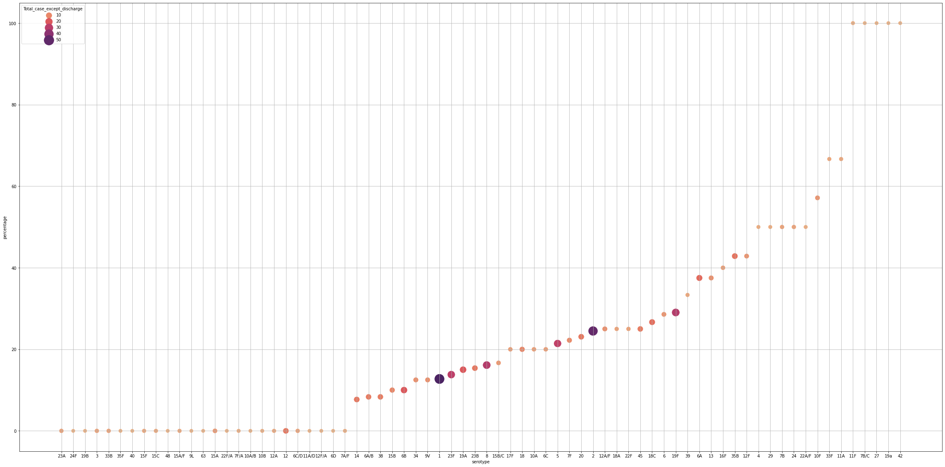
For Severity
Percentage
Serotype 5 (21.4285%)
Serotype 1 (12.7272%)
Serotype 19F (29.03226 %)
Serotype 2 (24.4898 %)
Serotype

Slide 21
Question 04:
Which serotypes are more likely to increase hospital duration?

Slide 22
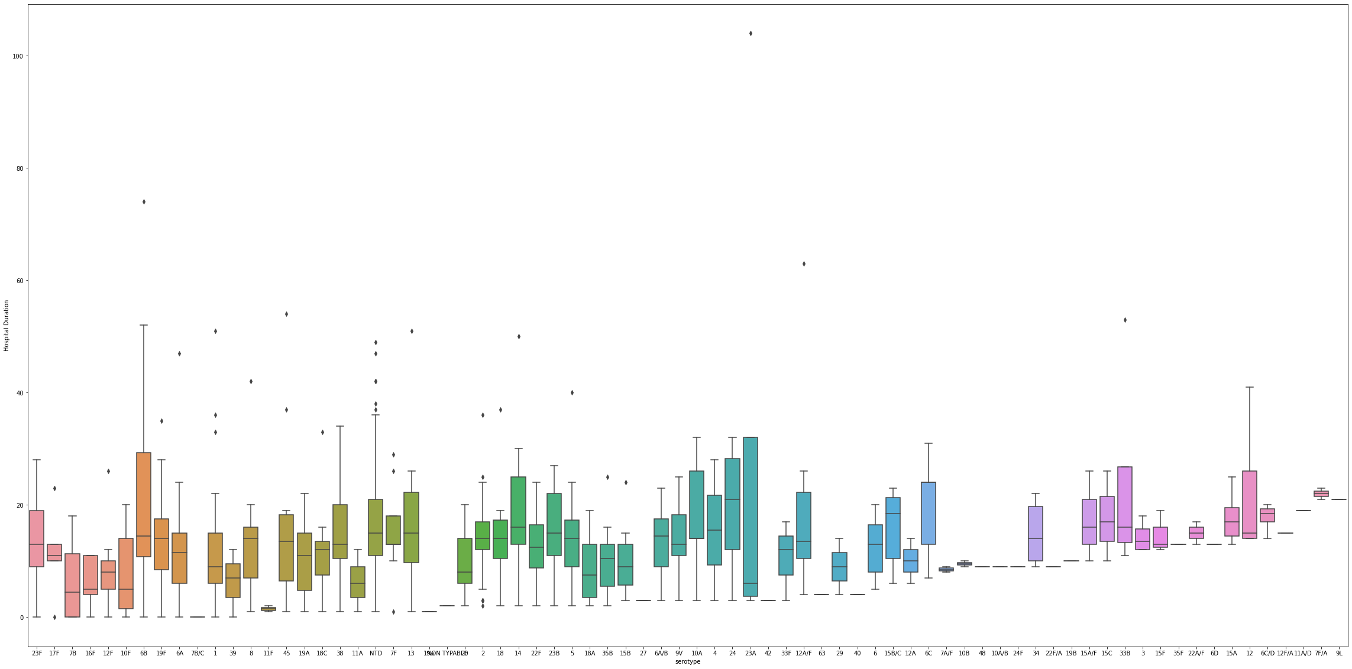
Hospital duration of different serotypes

Slide 23
Question 06:
Is there any correlation between age and serotype?

Slide 24
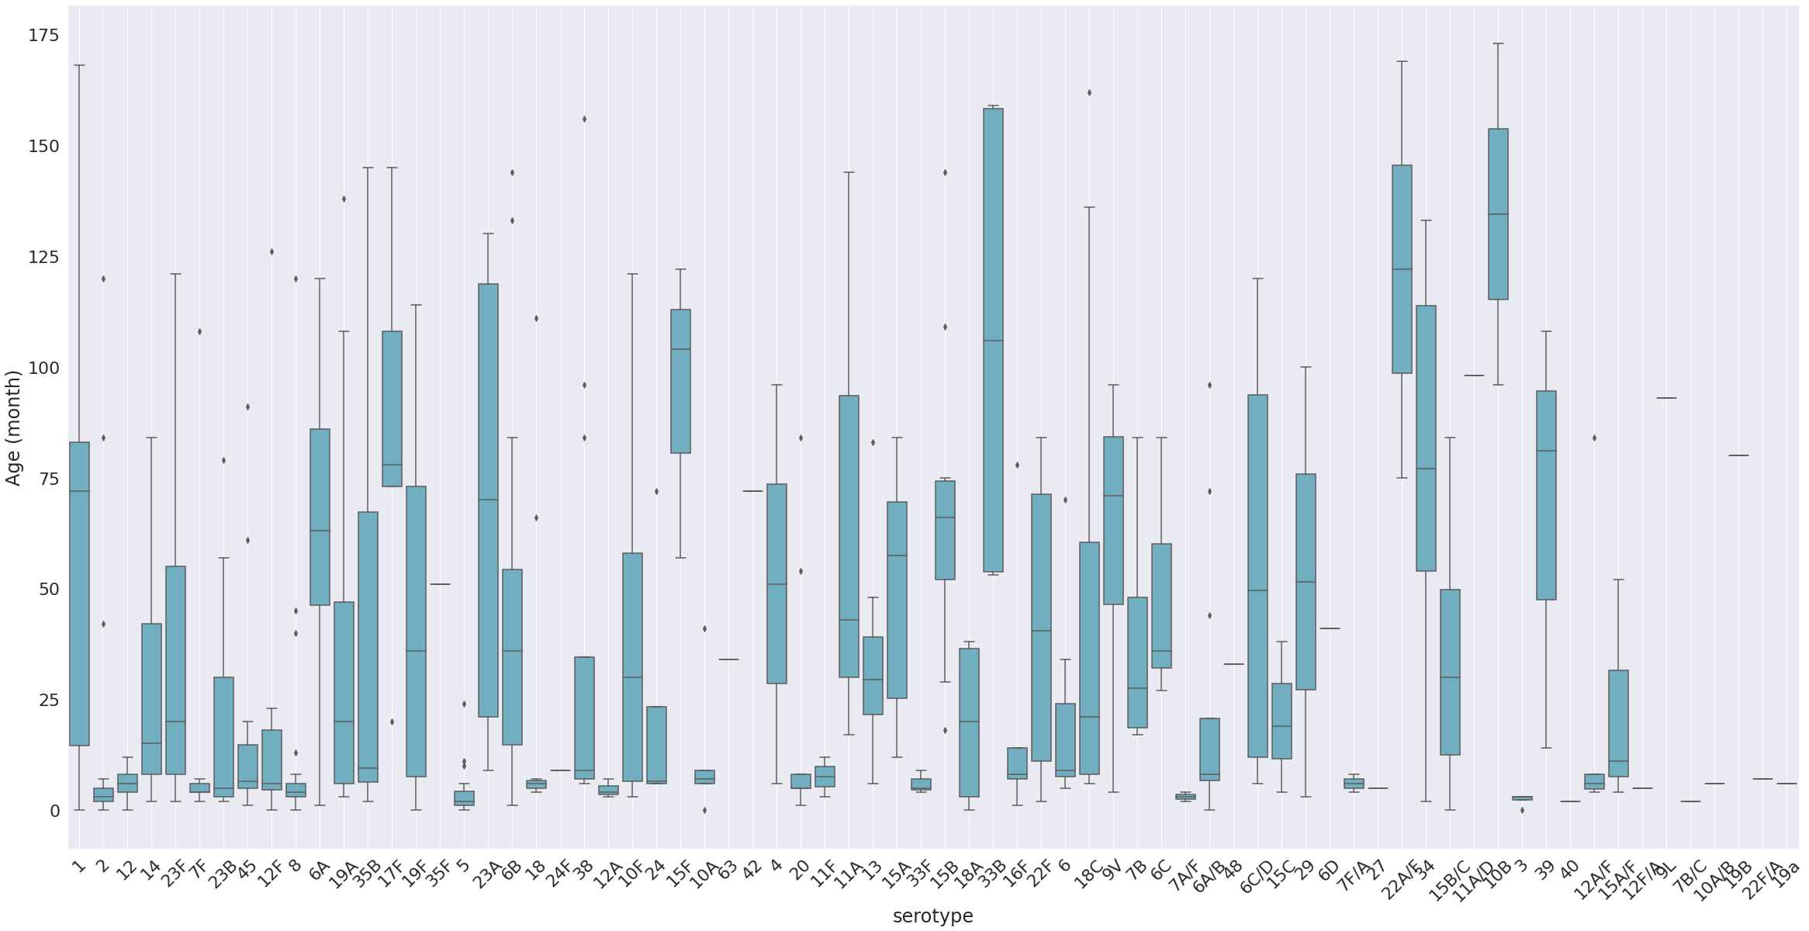
For all cases

Slide 25
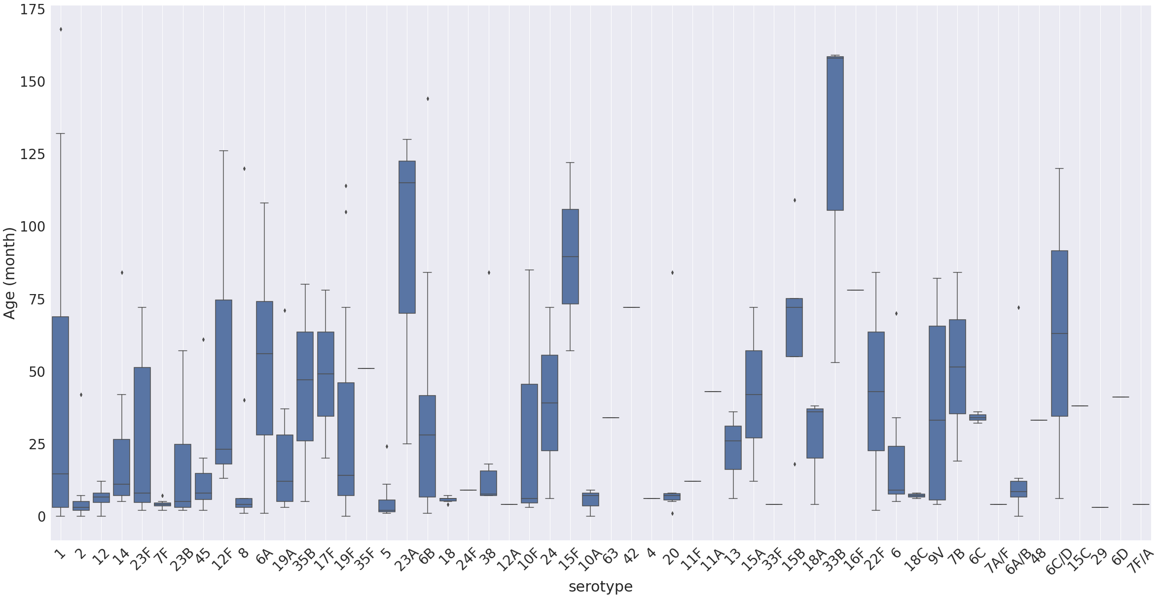
For Pre-PCV

Slide 26
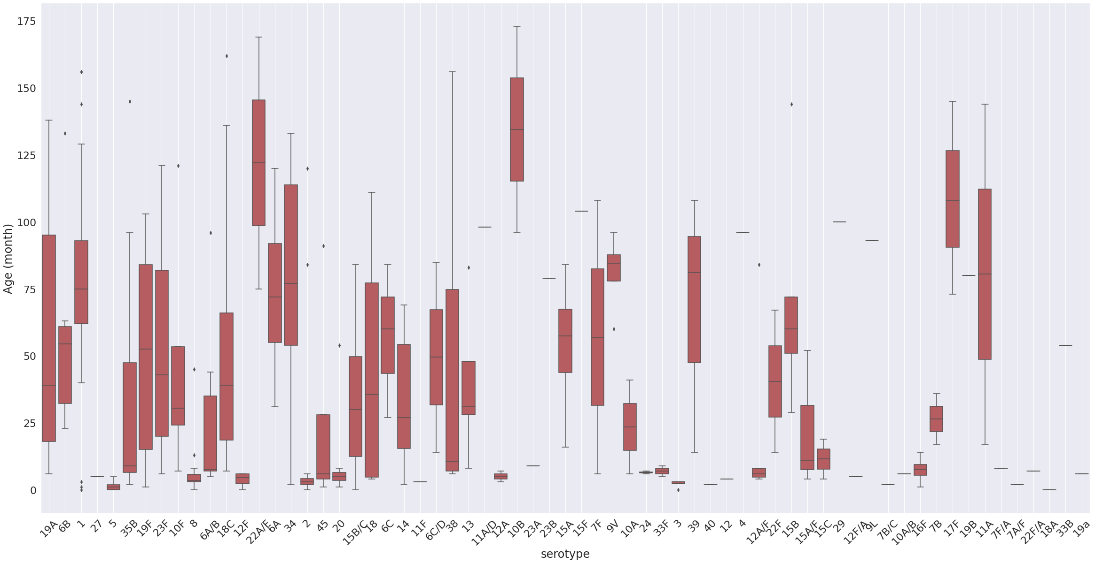
For Post-PCV

Slide 27
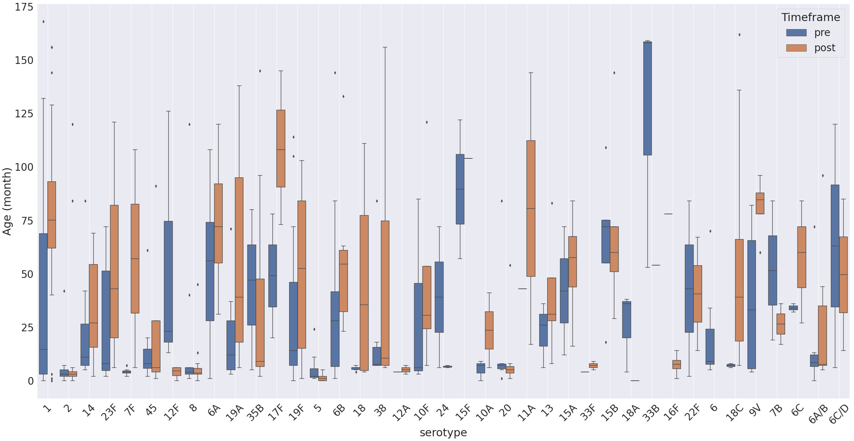
Pre Vs. Post

Slide 28
Question 05:
Geographical distribution of the serotypes?

Slide 29
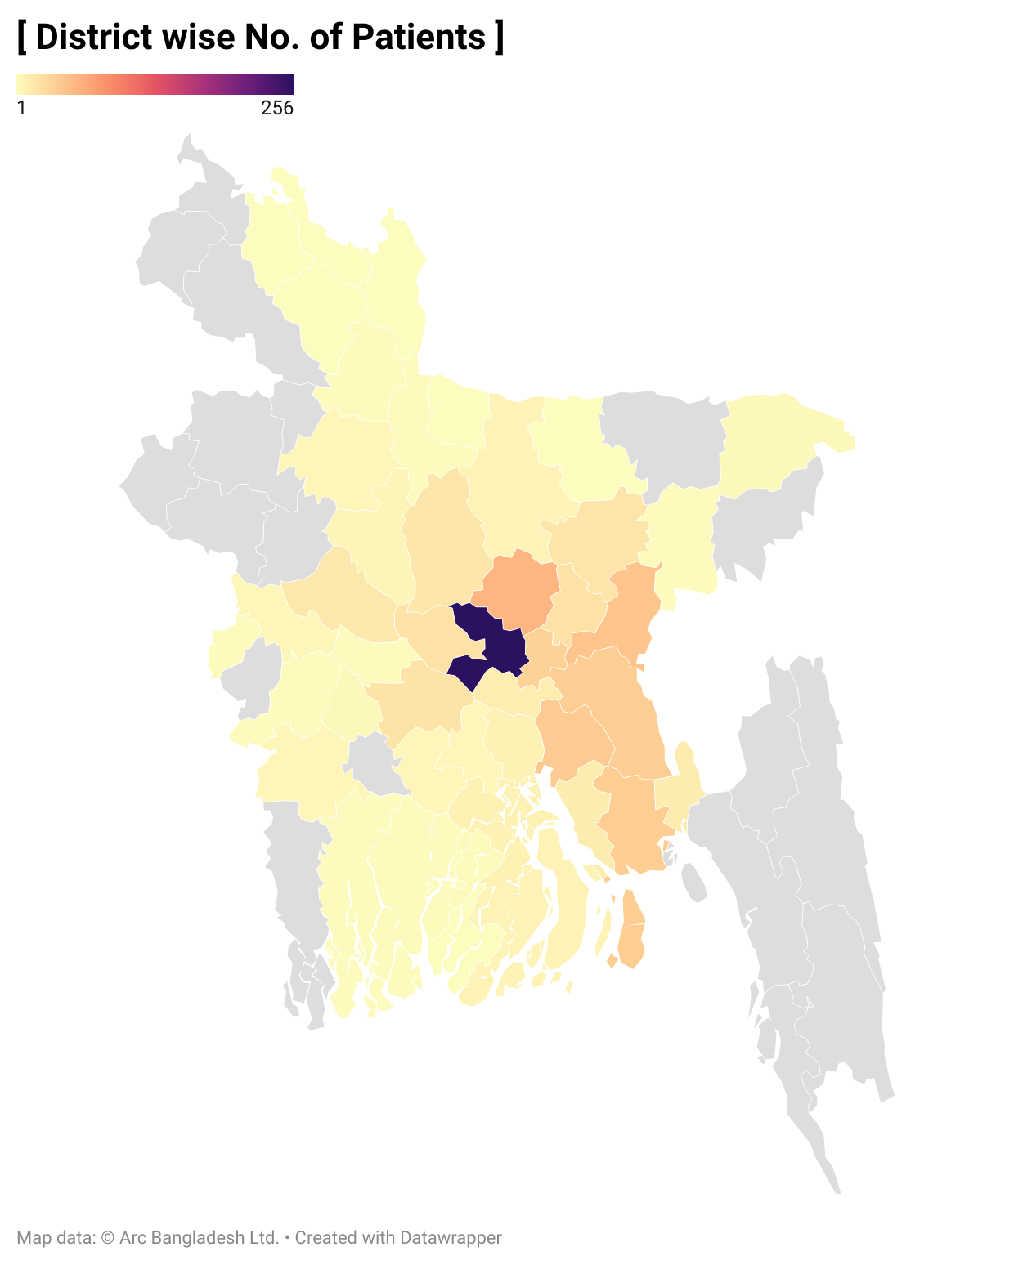
Dhaka has the highest no. of sample size.
Eastern side has better transportation facility. That’s why, we are getting larger sample from those districts.

Slide 30
Summary
Certain serotypes that are more severe: 19F, 2, 5, 1
Causes death: 19F, 5, 2, 1
Most likely to cause meningitis: 2, 5, 8, 1
Severe and causes meningitis: 2, 5.
Impact of PCV 10: 4, 5, 6B, 14, 18C, 19F, 23F
Transition of age group: 1, 7F, 12F, 17F, 18, 38, 24, 18C, 9V, 7B, 6C

Slide 31
Thank you

